Slide 1
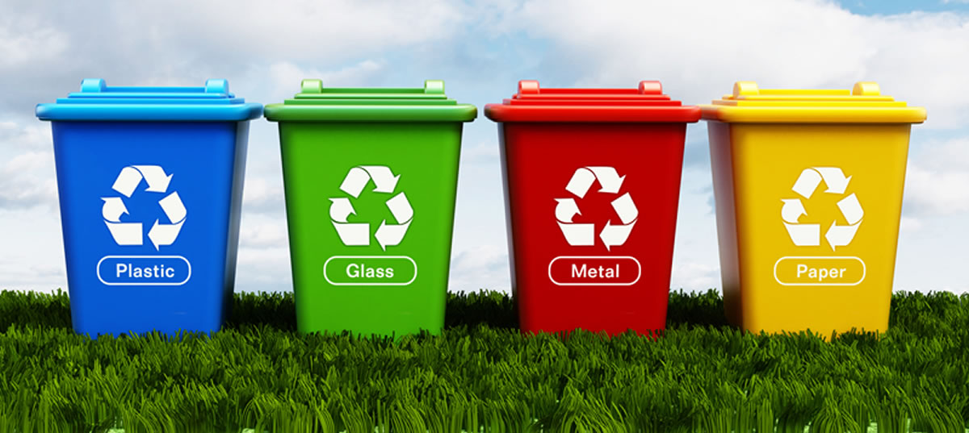
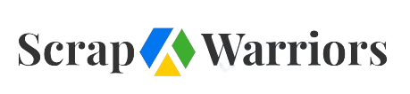
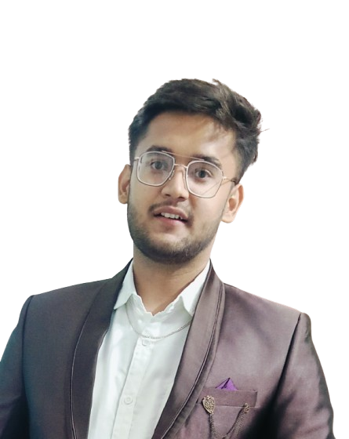
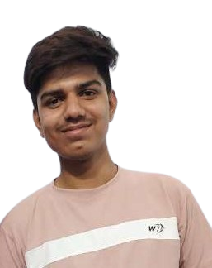
कचरे से भी पैसा है।
Varun Rajpal
S/O Mr. Chandra Prakash Rajpal
Founder
Ronit Soni
S/O Mr. Santosh Kumar Soni
Co-founder

Slide 2
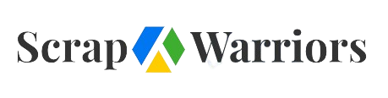
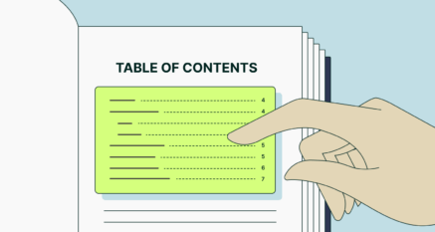
Table contents
What is waste management...?
What is the need for waste management...?
Idea for solving this problem (Scrap Care).
Business Model and Customer Benefits
After implementing effect

Slide 3
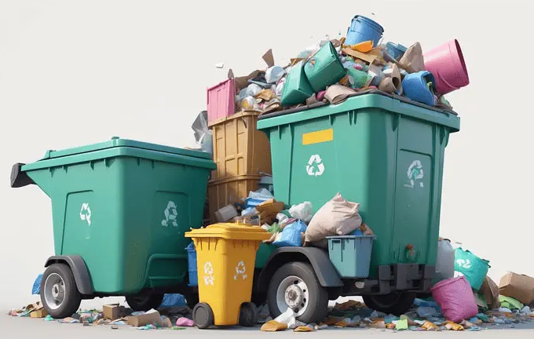
What is waste management..??
Collection.
Segregation.
Transportation.
Recycling.
Treatment.
final disposal.

Slide 4

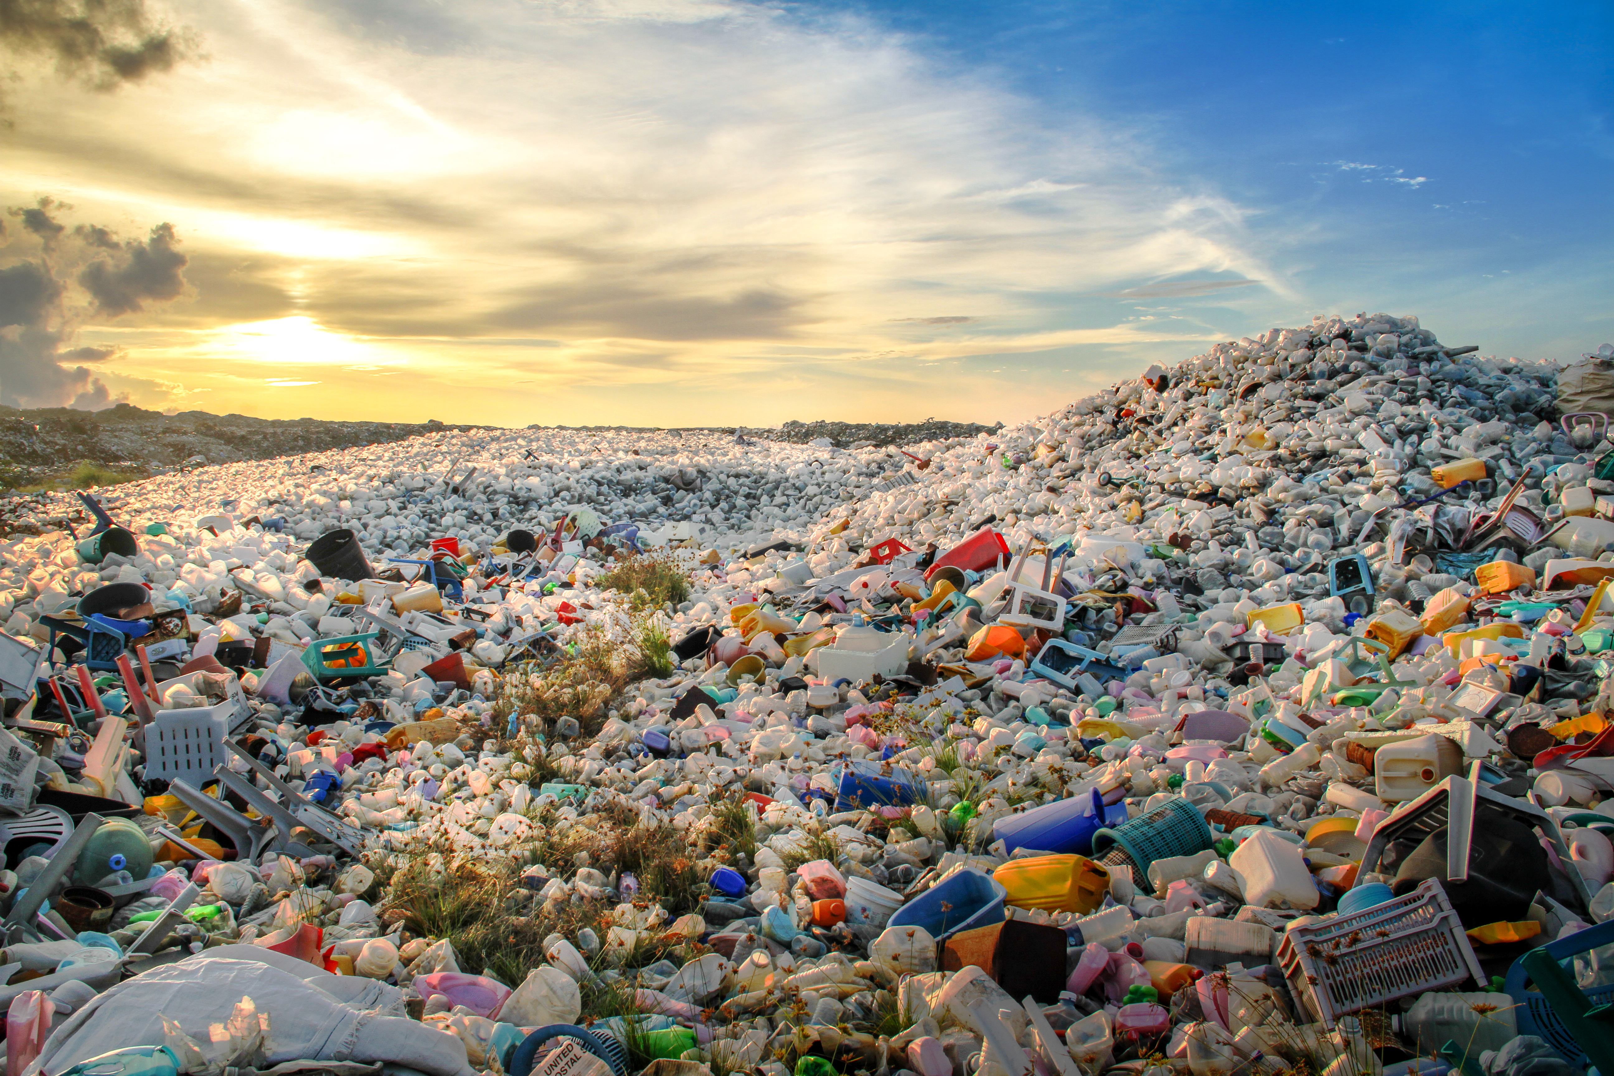
Challenges Faced
1.Improper Waste management.
2.Unorganized Market
3.Disrespectful Market
4.Low life standard

Slide 5
Solutions and Strategies
Cooperation with scrap dealers.
Benefit for us with scrap dealers.
Scrap dealers benefit by our app.
Partner with Reliable Recycling Facilities.
We have to make an app in which our all scrap dealers are there they have to choose prices according to their suitability if a normal person want to sell his or her waste he can contact our scrap dealer from that app so that he choose the right price for his waste this create transparency.

Slide 6

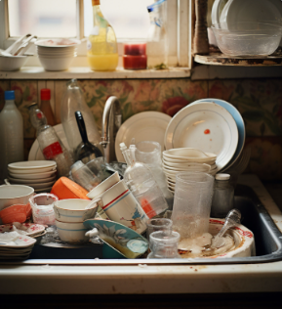
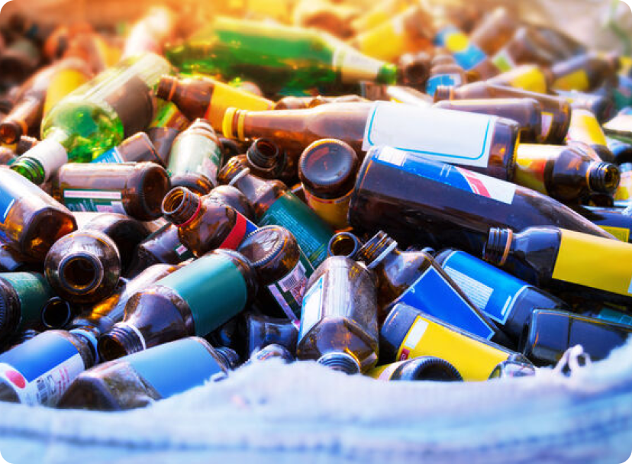
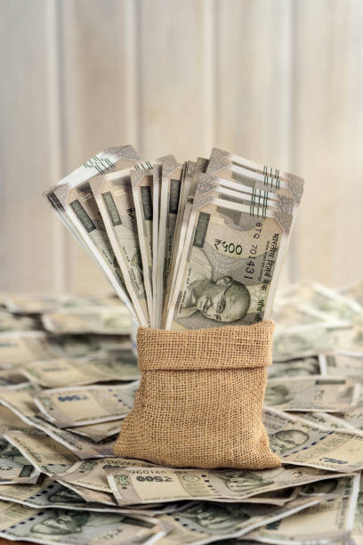
Business Model and Customer Benefits
Target Audience
Our primary customers are individuals seeking an easy way to dispose of unwanted waste materials from their homes.
Earning Potential
Customers have the opportunity to turn their unwanted items into
cash, making it a financially beneficial service.
Online Platform
We offer a user-friendly website where customers can list and sell their waste products at competitive prices.

Slide 7


Effect of implementation of this idea
Social Equality.
Increment in standard of living .
Waste will also managed properly.
per capita income also increases.
role of middle class will increase .
lower class will transfer to middle class.

Slide 8
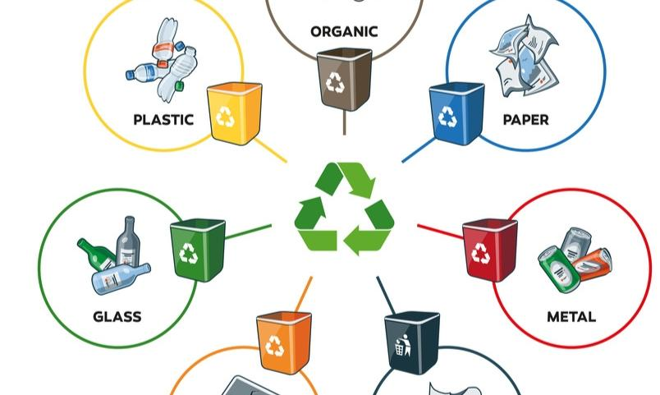

Thanks for Being Here with Us

